Slide 1
Group project:
Flint drinking water contamination ethics lecture
Working Ethics into the Conversation: Introducing STEM Faculty to Teaching Ethics
Oct 22-23, 2019
Mark Kennedy, Jennie Saxe, Ralph Stuart, Ramesh Talreja, Renee Walsh

Slide 2
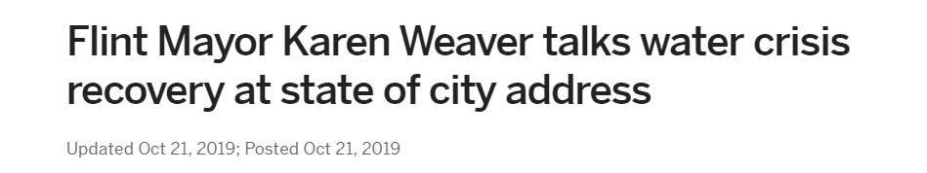
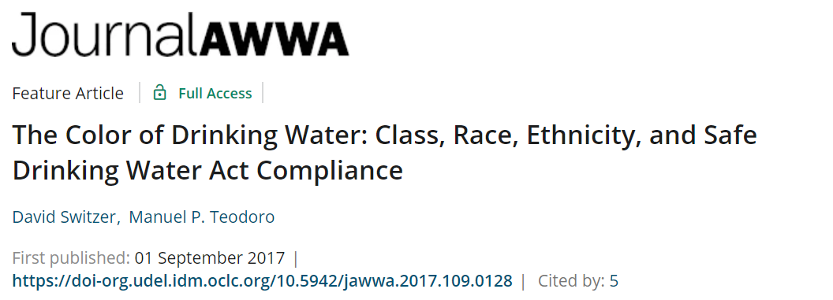
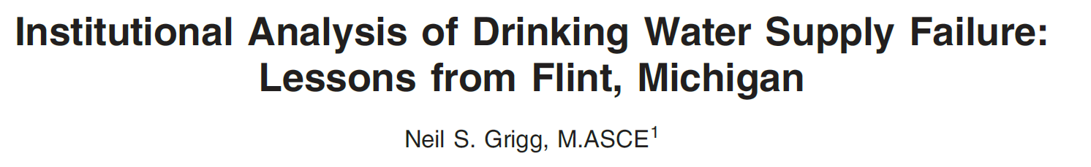
Real Case Study:
Flint Drinking Water Contamination
https://www.mlive.com/news/flint/2019/10/flint-mayor-karen-weaver-talks-water-crisis-recovery-at-state-of-city-address.html

Slide 3
Learning objectives
Summarize elements of ASCE and NSPE ethics codes
Identify the ethics violations that led to the contamination of the drinking water in Flint, Michigan
Explain the role of communication in ethical decision making
Recommend methods for addressing ethics issues in public sector engineering

Slide 4
Assumptions
75-minute class period
25 students in class
Pre-class homework has been assigned and completed:
  Find and read two news articles from two different sources about the contamination of drinking water in Flint, Michigan
  Find, read, and cite (in IEEE or APA format) 2 peer reviewed articles about the Flint, Michigan water contamination. Search on the databases Engineering Village (Compendex and Inspec) or Scopus.
  Review ethics codes: ASCE, NSPE

Slide 5
Class structure
Activity | Time allotted (min)
Welcome, review of learning objectives, warm-up | 10
Introduction to activity | 10
Activity (2 parts) | 30 (10 + 20)
Report-outs from activity | 15
Discussion wrap-up, reflection paper | 10

Slide 6
Warm-up: concept map
Write 3 words on the board related to the case study you read
Draw lines to connect any concepts which go together
Communication
Public health
Professional responsibility

Slide 7
Group activity: role-playing
Divide students into 5 groups of 5
Students will be assigned roles (5 students to each role)
  Water treatment plant manager
  Water treatment plant supervising engineer
  Water treatment plant operators
  Emergency financial manager
  Health department

Slide 8
Group activity: role-playing
Meet with your counterparts (like roles) for 10 minutes
  Discuss what your ethical responsibilities are and identify if/how those responsibilities may have been violated
  Use the NSPE and ASCE codes of ethics as a guide
Then split into groups comprised of one of each role
  Discuss in this diverse group what ethical issues you noted
  These groups will report out on their discussions

Slide 9
Discussion wrap-up
Instructor has a set of discussion questions prepared, including:
  What could you have done differently as supervising engineer?
  What about a conflict between fiduciary duties of financial manager and engineering codes of ethics?
  Are there any gaps in the ethics codes?
Additional points on class discussion:
  Instructor would describe why stakeholders were selected for this exercise (application of professional codes of ethics)
  Instructor should discuss additional stakeholders (e.g., city residents) who should be included in decision-making processes

Slide 10
Learning outcomes
Students have the ability to apply ethics codes to real-world situations
Students can identify and examine real-world situations for ethical violations

Slide 11
Reflection paper: assessment
Provide a reflection question and ask students to write a brief response at the end of class
  Examples:
    How could you ensure ethical decision-making in public sector engineering projects?
    What role does communication play in ethical decision-making?

Slide 12
Further Reading

